Slide 1
St Francis Region
Our Future

Slide 2
OFS Sisters & Brothers…

Slide 3
5-year projections using same rate of decline…..
Decline in Professed: 2012 to 2016 = 19%
Decline in Candidates: 2012 to 2016 = 28%
Using same decline rate 2017 to 2021
Professed in St Francis Region: 2021 = 521
Candidates in St Francis Region: 2021 = 38

Slide 4
10-year projections using same rate of decline…..
Decline in Professed: 2012 to 2016 = 19%
Decline in Candidates: 2012 to 2016 = 28%
Using same decline rate 2022 to 2026
Professed in St Francis Region: 2026 = 422
Candidates in St Francis Region: 2026 = 27

Slide 5
10-year projections using same rate of decline in Fraternities…
# of Fraternities in St. Francis Region 2011: 33
# of Fraternities in St. Francis Region 2016: 28
Using same decline rate 2011 to 2017 = 15%
# of Fraternities in St Francis Region in 2026 = 19

Slide 6
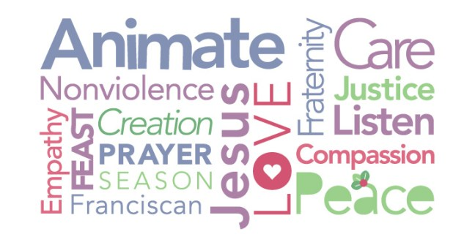
HOW CAN WE AFFECT CHANGE TODAY?

Slide 7
Discussion & Sharing…
1. What do I think my Fraternity will look like in 10 years? How might the meaning of Fraternity change in 2026?
2. What would I do without my Fraternity?
3. What can I do in 2018 to change 2026?
Put your thoughts on post-its and then bring them to the boards.

Slide 8
Question 1: Fraternity Profile in 10 years?
Maybe meet electronically/digitally.
Reduction of initial formation time to 2/2.5 years; not less formation/info, but can move faster by meeting for initial formation twice a month rather than just once.
Merging with other near-by Fraternities.
“Fraternity” is made up of smaller local groups who meet; together meeting once or twice a year.
End “language groups” and merge by locale.
More integration & affiliation with parishes.
Characteristics similar to OSB Oblates; local gathering where possible, larger gathering for retreat once per year.

Slide 9
Question 1: Fraternity Profile in 10 years?
MUST move from the “this is the way it always has been done” view; we must be inventive & creative.
Even current 2017 “numbers” do not accurately reflect those who are truly involved in Fraternity today(meetings, gatherings, works of mercy/charity, worship together, etc.)
“Fraternity” will come from the heart and action, not just a roster and attendance.
As we all age, we must learn to care for our own. “Emeritus” status is a GREAT step in this direction. More recognition of aging/changing reality by NAFRA & CIOFS.
Franciscan Family together, not just Seculars.

Slide 10
Question 2: Life without Fraternity?
I would rather merge with other Fraternities than loose time with my sisters and brothers.
NOT something I want to think about. The profile of Fraternity would change, but I need to have this spiritual support/commonality in my life!
Everyone is scared of losing local identity. We must look at the ORDER and not just groups.
We must remember we Professed to SECULAR FRANCISCAN ORDER, not just membership in St. Joaquim Fraternity. We must think outside of Fraternity, the parish, the 1st Order, & diocesan loyalties; the ORDER must be first. We must live by OUR Rule, OUR Constitutions. If not, we won’t survive because our loyalties are misplaced. We “cannot serve two masters.”

Slide 11
Question 3: Do in 2018 →  2026 ?
Better, more innovative use of technology.
Become more visible in parish/communities.
We seem to be afraid of the word “ADVERTISE”, like it’s a bad thing. It makes us visible.
Like Sylvia Paoli says: “No one ever had a vocation to an Order they never heard of!”
Outreach; Outreach; Outreach. INVITATION!
T-shirts, hats, shirts, jackets: Not Fraternity name, more SECULAR FRANCISCAN ORDER!
Be a witness through action, deeds, & WORDS.

Slide 12
Thank You!

