Slide 1

Taming the Wolf
Peace through Faith
Resolving Conflicts Ruining Your Life
Notes:
Ministry: Bringing Christ’s Peace to the World, one heart at a time.
Join St. Francis in rebuilding His House with a ministry of peacemaking.

Slide 2

Notes:
Manual combines contemporary approaches with peacemaking legacy of St. Francis.
Print, e-book, and online PDF versions.

Slide 3
MEDIATION
Art of Restoring Harmony by seeking Unity in the Presence of the Holy Spirit.
Notes:
Faith-Based Definition

Slide 4
“...an essential responsibility of the Church, namely, a well-ordered love of neighbor.”
– Deus Caritas Est, Benedict XVI
Notes:
Process & Structure bring “well ordered” nature to love.

Slide 5
After the Fall
Notes:
Exercise of Free Will results in non-aligned intentions.
In Fallen World, random intentions come into opposition.
Intentions collide; we have conflict.

Slide 6
Conflict Created by Opposing Forces
Notes:
Conflict not just a problem. Intentional agents oppose one another.
One free will opposes another free will.
Opposing goals, intentions, views, desires, interests, needs.

Slide 7
Align with
Will of God
Notes:
To align intentions, seek to understand Will of God. Applied Pastoral Theology: Align Free Will with Will of God. Foundational concept of Faith-based Reconciliation
BRAINSTORM: How do we know the Will of God?

Slide 8
“The love-story between God and man consists in the very fact that this communion of will ...
Notes:
The theology of Cardinal Ratzinger (Pope Benedict XVI) provides a foundation for our work.
See The Word Made Love.

Slide 9
... increases in a communion of thought and sentiment, and thus our will and God’s will increasingly coincide...”
— Deus Caritas Est, Pope Benedict XVI

Slide 10
Christ the
Mediator
God
[ Trinity ]
Priest as mediator
15
Brother
Notes:
Seek to reconcile parties with God.
Often we do not think of separation from God as conflict, but it represents conflict with the WIll of God.

Slide 11
Mediator
Reconciliation
Brother
Brother
Notes:
Reconcile brothers using mediation, reconciliation protocols, collaboration.

Slide 12
God
[ Trinity ]
15
15
Brother
Brother
Notes:
Reconcile along two axes simultaneously: 1) Reconcile brothers (neighbors) with each other. 2) Reconcile parties with God.
Axes are linked. Change one, you change the other.

Slide 13
... love of neighbor is a path that leads to the encounter with God and ... closing our eyes to our neighbor also blinds us to God.
— Deus Caritas Est, Pope Benedict XVI

Slide 14
FALSE SELF vs.
Divine Self
Notes:
False Self is the conflict driver. Hidden variable.
Faith formation. Reflection. Contemplation. Prayer.

Slide 15


Two False Selves Fight
Notes:
Move past False Self to see Divine in the Other.
Move past False Self of the Other to touch them.
Basic conflict resolution choreography.
RESOURCE: False Self Quotes

Slide 16
Dour Combat
Fighting
Spiritual Warfare
Put on Spiritual Armor
St. Peter’s Dilemma
Notes:
Peacemaking and spiritual warfare - related?
Christ taught New Way to fight opposition to Will of God.
Pope Francis - homily of 30 Oct 2014 - Ephesians “Put on the Spiritual Armor”

Slide 17
The whole of man’s history has been the story of dour combat with the powers of evil...
CCC 409
Notes:
EXERCISE: Dour Combat survey

Slide 18
Matthew 18:15 Interests
Matthew 18:16 Rights
Matthew 18:17 Power
Notes:
Scripture suggests dispute resolution protocol.
Start informal; move to formal as needed.

Slide 19
Power
Rights
Interests
Notes:
Power (authority) enforces a decision.
Rights are litigated to enforce a claim.
Interests negotiated in collaborative effort.

Slide 20
Positions
Interests
Notes:
Key concept: “Go Below the Line”
“Slow it up.” Move from emotional to analytical space.
Positions usually satisfied in only one way.
Interests can be satisfied in a number of ways.

Slide 21
Visioning Interests
Notes:
Chart party interests. [See Workbook] Discover the relative importances.
Do not inadvertently negotiate for items of little value.

Slide 22
Human Needs
& Spiritual Needs
Notes:
Secular culture tends to overlook spiritual needs.
See Taming the Wolf for more.

Slide 23
Assess
Be, Do, Have
Notes:
Name it with Be Do Have. Bring order to confusion. Identify exact items opposed.
Who opposes our need to BE ...? Who do we oppose?
Who opposes our desire to DO... ? What freedom you oppose?
Who opposes our desire to HAVE... ? What do you oppose?

Slide 24
Compete
Collaborate
Satisfy Own Interests
Compromise
Avoid
Accommodate
Satisfy Other’s Interests
Notes:
All responses are appropriate in specific circumstances.
What is the best response for the situation?

Slide 25
Self
Avoid
Other
Notes:
May be valid, but often habitual. No interests satisfied. Parable of the Good Samaritan. We walk on other side of the road. Avoidance may mean a false peace. Yet, at times, it is valid to seek safety from imminent violence and buy time.

Slide 26
Accommodate
Satisfy Other’s Interests
Notes:
A servant satisfies needs, washes feet. BUT should not allow a narcissist to compete covertly by playing victim. This leaves one feeling cheated, empty.
If we fall into apathy, our resentment builds. When others cannot contribute, their resentment builds. The solution is to seek mutual satisfaction.

Slide 27
Compete
Self
Notes:
Healthy or unhealthy. Ethical and honest or unethical and underhanded. Games are competition w/ elements of collaboration: rules, playing field, mutual participation.
Narcissist (sociopath) may assume victim posture to satisfy needs covertly. Humble servant is prime target. Unhealthy dependence and deception.

Slide 28
Compromise
Self
Other
Notes:
Compromise “divides the pie.” May be good will gesture. We satisfy and sacrifice, win and lose. However, we may feel we “settled.” Additional value is unrealized. Mutual partial loss diminishes relationship. Compromise may be necessary to move beyond impasse but compromise can make us feel “distant.”

Slide 29
Collaborate
Self
Other
Notes:
Collaboration honors relationship. Mutual creative satisfaction of interests results in increased value and expanded pie. Ideal approach - something we strive toward.

Slide 30
Distributive vs. Integrative
Bargaining
Cut the Pie
Expand the Pie
Notes:
With compromise we divide the pie, in a distributive solution.
With collaboration we expand the pie, with a solution that integrates needs.

Slide 31
Divine
Collaboration
Satisfy Own Interests
Satisfy Will of God
Satisfy Other’s Interests
Notes:
Seek “Divine Collaboration.” Consider party interests in relation to Will of God. Not only self or others interests, include God. Relationship with neighbor includes Divine. Negotiate beyond mundane to transcendent interests. Potential for a significantly deeper level of satisfaction.

Slide 32
Make Me a Collaborator
How can I help you become a collaborator?
What bad habits will you need to overcome?
What will remind you to seek mutual satisfaction?
What helps you align with the Will of God?
Notes:
Pair up with another participant. Take turns interviewing one another.

Slide 33
Convening:
Getting to the Table
Notes:
The first step get parties “to the table.”
This can be as difficult as actual mediation.
Priest in a parish may be a “convener.”

Slide 34
Safety,
Hope & Willingness
Notes:
Task = Get parties to the table.
Result = Willingness to participate.
How = Create Safety and Hope

Slide 35
Barriers to Convening
Notes:
Identify factors that block the path. Use discernment to overcome barriers, and increase safety, hope, and willingness.
Why do parties refuse to convene?

Slide 36
Expectations
Failed
Unstated?
Notes:
Expectations disappointed. Party did not receive what they feel they deserve.
Expectations may be unexpressed, unstated.

Slide 37
Need to
Be Right
Being Made
Wrong
Notes:
Right = survival. Wrong = non-survival.
Being right unconsciously associated with survival. Becomes overly important. When made wrong, survival is threatened even when minor issue.

Slide 38
Emotions Color
Story & Perceptions
Notes:
Emotions skew perceptions. Parties may not see clearly.
Desires, needs, loss, and fear of opposition drive emotion.

Slide 39
Destructive Emotions
Notes:
Anger. Rage. Fear is primary conflict driver.
Fear tied to adverse consequences. Our fears define our opponent.

Slide 40
Faulty Perceptions
Notes:
Destructive emotions cause inaccurate perception.
Mediator helps with “reality checks” that allow a party to regain accurate perceptions.

Slide 41
Desire for Revenge
\
Notes:
Revenge = enforced empathy. A party wants the other to feel how they felt.
Explore range of interests and consequences to illustrate how revenge may be inappropriate.

Slide 42
False Attributions
Notes:
We attribute bad character / negative disposition.
We create an inner story for the other.
Sharing narratives remedies false attribution.
Details of respective stories filled in.

Slide 43
Facework
Notes:
PROTECT FACE, SAVE FACE, RESTORE FACE
DISRESPECT creates Face Threat. Self-image in jeopardy.
Mediator RESTORES FACE. Reason a mediator is needed.

Slide 44

Identity
Public image we want others to share
Claim to be a certain kind of person
Positive social value we claim
Need to be included (fellowship face)
Need to be respected (competence face)
FACE
Notes:
Conflicts arise when Face needs violated.
What role does respect play in the conflict?
Has someone shown disrespect?

Slide 45
Face-saving messages:
Speaker trying to maintain self-image, public image
Attempt to negotiate relationship
Defensive response to perceived threat
Notes:
Listen for messages that signal Face Saving need that inhibits reconciliation. Manage Face. May need to Protect Face as you uncover previous Face Loss. Party may hesitate to admit Face Loss, as that may admit they were weak.

Slide 46
You did ...
I felt ...
Notes:
NOT... “You made me feel this way.”
Focus on “What I felt. What I need.”
NOT... “What you did to me.”
Avoid Blame and Shame. Avoid victim pose.

Slide 47


The Face of a Franciscan
Notes:
Francis saw God in all creatures. The Image of God in the other.
(See works of Fr. Murray Bodo.)
Primary method of handling FaceWork.
ANTI-BULLYING POSTER

Slide 48
Framing
Notes:
Framing communicates without triggering defensive stance.
Mediator models framing, helps party frame comments, requests, complaints.

Slide 49
Telling Your Story
Notes:
“Tell me, what happened?” Open-ended question.
Mediator facilitates narration: facts, feelings, perceptions, views, desires.
Seeks acceptable narrative; works toward a shared narrative for the future.
False Self narrative undergoes transformation.

Slide 50
Funnel
Questions
Open-Ended
Clarifying
Close-Ended
Notes:
Open-ended questions. Party tells story in own words; self-selects importances.
Clarifying questions. Clear up confusions or uncertainties.
Closed-end questions. Verify details and facts, often yes or no.

Slide 51

The “what happened” conversation.
The “feelings” conversation.
The “identity” conversation.
Notes:
Mediator facilitates multiple conversations.
Perceives “broadband” communications.

Slide 52
Listening to Self
Notes:
A party has an opportunity to listen to self and ask:
Does my story reflect who I am? Or does it ring false?
In contemplative prayer ask, “What must I transform?”

Slide 53
Active Listening
Notes:
Mediator listens. I-Thou relationship. Truly present.
Listens to more than words.

Slide 54
Notes:
Flawed communication - sender and receiver have different pictures in mind.
Mismatch is a source of conflict. Presents difficulty in resolving conflict.
Mediator assesses communication for duplication.

Slide 55
Notes:
Seek to understand - to duplicate, to make an accurate copy.
Mediator coaches. Works through perceptual distortion.

Slide 56
Mirror Exercise
Notes:
Spolin Theater Games - Mirror

Slide 57
pow•er noun the ability to affect the decisions, actions, and behavior of others
Notes:
Not coercion and domination.
If you conform the outcome to your intentions - you have power.
If the outcome does not match your desires - you have no power.

Slide 58
Types of Power
Notes:
Expert; Resource; Personal; Referent; Exchange; Hierarchal (status); Reward; Punishment; Spiritual; Divine Providence.
We often overlook power we possess. Engage in a thorough assessment.

Slide 59
Negotiate
Use of Power
Notes:
We negotiate the use of power.
We seek power that enable a collaborative negotiation.
Power may be held in abeyance during a mediated negotiation.

Slide 60
Increase security and love.
Notes:
Provide safety and hope to convene.

Slide 61
APOLOGY
MUST SATISFY NEEDS
Notes:
Apology must satisfy the needs of the harmed party.
If needs are satisfied, apology will be accepted. If needs not satisfied, apology will be rejected.
If an apology is rejected, assess and debug. What needs are not being met?

Slide 62
apology shows respect
Demonstrates humility
Uplifts the Other
Restores dignity to harmed party
Reverses invalidation
Shifts focus to the Other
Notes:
ERRORS:
Failure to show respect.
Superior attitude.
Apology mumbled as an aside.
Attempt to maintain dominance or coercion.
Offender concerned with his status, not the status of the harmed party.

Slide 63
apology offers expression of concern
Demonstrates we feel their pain; we recognize their suffering
Conveys we “get it”
Tells them “we feel what you feel”
Promises we’ll not cause more pain
Notes:
ERRORS:
Failure to communicate an understanding of the severity of harm.
Counterfeit empathy that fails to connect with other’s pain.
Questioning or challenging the victim’s suffering.

Slide 64
apology expresses acceptance of responsibility
Communicates we accept being cause
Signals we seek to gain control of our actions
Signals harm will not be repeated
Notes:
ERRORS:
Apologizing for wrong or unimportant act.
Deflecting blame; assigning blame to victim.
Claiming not responsible for own actions.
Failure to grasp how transgressions harm relationship.

Slide 65
apology expresses regret for violating moral grain of universe
Communicates moral perspective
Communicates ability to judge right from wrong
Provides comfort regarding future; harm will not be repeated
Notes:
ERRORS:
Regret detached from moral relationship.
Refusal to exercise moral choice.
Violation of moral ground of relationship.
Violation of Golden Rule.
Denial of moral grain of the universe.

Slide 66
apology signals offender seeks forgiveness
Requests “take away my guilt”
Demonstrates humility
Honors Other by request for help
Notes:
ERRORS:
Focus on relieving burden of transgressions; excluding concern for harmed party.
Lack of balance between absolution and restitution.
Assuming apology warrants forgiveness.

Slide 67
apology expresses willingness to make amends
Signals willingness to restore balance
Pledges to make world right again
Offers restitution
Notes:
ERRORS:
Offering restitution to wrong party.
Failure to plan restitution in meaningful way.
Restitution not grounded in reality.
Failing to balance restitution with harm delivered.

Slide 68
apology removes insult from injury
Restores face
Restores respect
Addresses the emotional injury of insult
Notes:
ERRORS:
Failure to recognize psychological and emotional damage.
Failure to acknowledge negative effect on other’s identity.
Failure to recognize Face Loss; failure to Restore Face.
Forcing other to express weakness or vulnerability.

Slide 69
apology signals desire to reconcile
Communicates change of heart
Signals relationship has value
Signals Other person is valued
Notes:
ERRORS:
Failure to clearly communicate desire for reconciliation.
Apology appears tactical or insincere.
Inciting distrust by not clearly communicating remorse.
Failure to honor freedom of harmed party to reject the apology.

Slide 70
apology promises harm will not be repeated
Signals control has been regained
Removes fear of sociopath lacking remorse
Communicates remorse and concern
Notes:
ERRORS:
Failing to acknowledge repeating pattern of harm.
Failure to show remorse; unfeeling psychopath.
Failure to pledge to not repeat harm.
Failure to offer realistic plan for behavior change.

Slide 71
apology acknowledges free will
Shows understanding that actions are a matter of choice, not chance
Expression of self-control
Notes:
ERRORS:
Apology that appears coercive or manipulative.
Failure to express apology as expression of free will.
No convincing expression of self control.

Slide 72
apology promotes spiritual growth
Restores relationship with God
Opens door to repentance
Re aligns our will with God’s Will
Notes:
ERRORS:
Failure to endow apology with sufficient respect.
Failure to examine conscience.
Failure to speak from heart and soul.
Failure of apology to lift up the other.
Failing to strengthen divine relationship.

Slide 73
apology explains why things happened
  Helps restore reality
  Reduces confusion
  Reduces sense of unreality
  Increases certainty for party
Notes:
ERRORS:
Unclear or illogical explanation; confusion or mystery. Lack of clarity.
Justifying or denying actual events or transgressions.
Failing to clarify previous deception; failure to set record straight.

Slide 74
apology opens door to mediation
Supplies concession needed to convene
Signals willingness to communicate
Signals willingness to collaborate
Provides safety and hope
Notes:
ERRORS:
Failure to solicit apology as opening concession.
Failure to create sufficient safety for an apology.
Failure to recognize face-saving role of an apology.

Slide 75
apology motivates confession
Parallels confession
May motivate deeper confession
Induces examination of conscience
Notes:
ERRORS:
Interrupting emerging confession.
Failure to hear and acknowledge confession.
Failure to allow confession to deepen so as to unburden wrongdoer.

Slide 76
Forgiveness
Notes:
Forgiveness is a transcendent gift, from God.

Slide 77
Forgiveness makes no sense.
It is NOT rational.
Notes:
Forgiveness is not logical. It is not a product of rational thought.
Forgiveness does not arise from reason, but rather from God’s grace.

Slide 78

Justice
Forgiveness does not balance the scales
Notes:
When we forgive we do not seek to balance the scales. We accept scales are not balanced.
Secular world has difficulty understanding forgiveness, as they do not know God’s forgiveness.

Slide 79
To Forgive
Is an Act of Will
Notes:
Forgiveness is a decision. A choice. An act of Free Will.
We decide to forgive, then we learn how.
We jump and then learn to fly.

Slide 80
Downside to Revenge
Burden of Guilt
Low Self-Esteem
Remorse
Spiral of Retribution
Self-Deception
Notes:
Adverse consequences accumulate when we act out an urge for revenge.

Slide 81
Diminished Consciousness
Buried Memory Triggered
Drink, Drugs, Depression
Clouded Reality
Wounds Shadow Us
Wounds Fester, Become Poison
Notes:
Adverse consequences accrue when we seek to diminish or eliminate our consciousness of wounds.

Slide 82
Victim Identity
Victim Identity Addictive
VI endowed with False Value
Covert Revenge - Shaming
Debilitating Loss of Dignity
Notes:
Negative outcomes can accompany our decision to assume a victim posture.

Slide 83
Attachment to Fairness
Endless Tit-for-Tat
Unable to find Balance
Retribution Unending
Stuck to Other Party - Trapped
Unfair Universe - We Blame
Notes:
Seeking the peace of heaven while in the worldly realm, may be futile.
We become bitter when we discover the Fallen World is not ideal, not heaven.

Slide 84



Self-Forgiveness
Accept
Divine Forgiveness
Notes:
Without experience of divine forgiveness we are unable to forgive self. We cannot imagine we deserve forgiveness.
Christ’s forgiveness empowers us to forgive another. Only solution to the world’s problems.

Slide 85
Acknowledge
Free Will
Notes:
In choosing to forgive we recognize we have been endowed with Free Will.
Through sanctifying grace we act from a supernatural perspective.

Slide 86
Retreat into Solitude
Notes:
Retreats. Hermitage. Time outs.
Seeking quiet. Stillness.

Slide 87
Uncovering False Self
Art of Spiritual Direction
Notes:
Do aspects of our identity seem fundamental, but are attachments to falsehoods?
What must be jettisoned to free us from sticky flypaper of conflict?

Slide 88
IMPASSE
Notes:
Parties in conflict can become stuck in impasse.
Flypaper, quicksand, spider web.

Slide 89
The Hidden Influence
Notes:
Easy to identify causes present, but difficult to identify missing, invisible, or hidden influences.
When assessment does not make sense - we look for hidden influences.

Slide 90
Opposition to Will of God
Problem of Evil
Notes:
We may discover intentions, acts, desires, and positions that oppose God.
We recognize as evil.

Slide 91
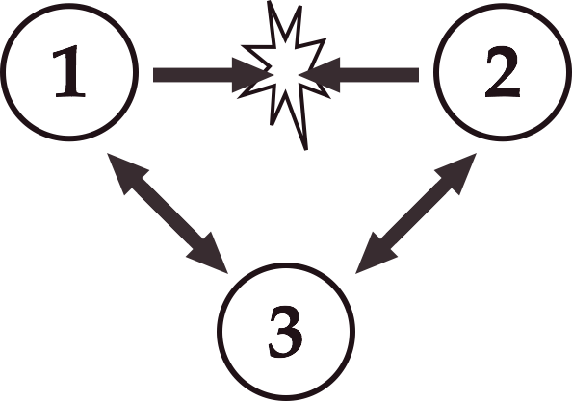
Destructive Third Party
Notes:
Primary driver of unresolved conflict is a hidden influence. The destructive third party.
Disparages Party I AND II, causing suspicion, alarm, distrust or fear. Parties fail to discover cause. In Genesis, the Serpent is a destructive third party.

Slide 92
When Evil Overwhelms
Notes:
When we abandon free will and responsibility, we blame nature, the universe, or God. We may abandon God’s grace. We become trapped in worldly imperfection.
St. Peter was forced into a new approach in the Garden of Gethsemane; We, too, must learn anew.

Slide 93
Managing Deception
Notes:
Identify and manage deception, a tool of the Destructive Party.
Redraft narrative to correct benign deception. Also address serious and intentional deception.

Slide 94
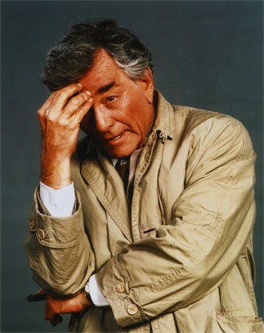
Notes:
In the manner of television detective Columbo (Peter Falk), the mediator assumes the role of harmless bumbler, as he seeks clues that reveal the true situation.

Slide 95
Discernment
Notes:
Discernment is vital if we are to identify the true nature of the conflict.
A mediator facilitates discovery and discernment, bringing about accurate perceptions.

Slide 96
Identify the
Third Party
Notes:
When parties recognize the hidden influence, its effect dissipates or disappears. Often this is all that is needed for conflict to resolve.

Slide 97
False Attributions
Notes:
Mediation provides a “safety check” with rigorous discovery built on shared narratives.
False attributions, if not recognized and corrected, can destroy relationships and scuttle reconciliation.

Slide 98
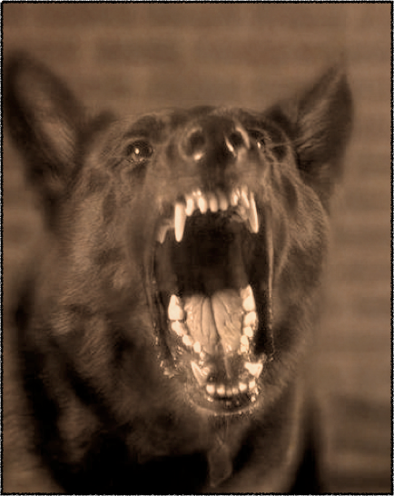
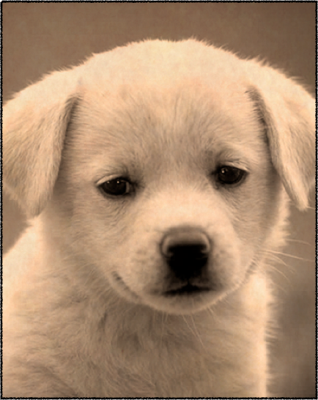
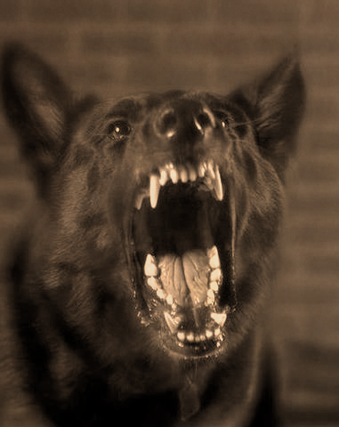

Notes:
The dilemma of discernment: we may fail to recognize evil intentions and suffer a bite, or we may attribute evil where none exists, foreclosing loving relationships.

Slide 99
Destructive scale:
Situation-based Fear
    Wounded Nature
Deep-rooted Fear
Notes:
Fear and the resulting evil intentions / actions may arise from situational factors, from unhealed wounds, or from existential fear.

Slide 100


Situation-based
Fear
Notes:
Organizations, families, or groups may operate in ways that cause insecurity and fear of being rejected, fired, harassed, or ridiculed. Their position in the organization is constantly at risk.

Slide 101

Situational Solution
Notes:
Remove fear. Increase security. Repair relationships. Remedy misunderstanding. Improve communication and perception. Establish transparency. Heal wounds triggered by environment. Adopt procedures and policies that provide security.

Slide 102
Challenging
Difficult increase love reduce fear
Notes:
The amount of difficulty increases when fear emerges from persistent deep wounds.

Slide 103
Healing
Personal
Wounds
Notes:
Assess and heal lingering wounds. May require special healing program.
May be physical, emotional, or spiritual, and may require additional help.
May give rise to proxy battles.

Slide 104
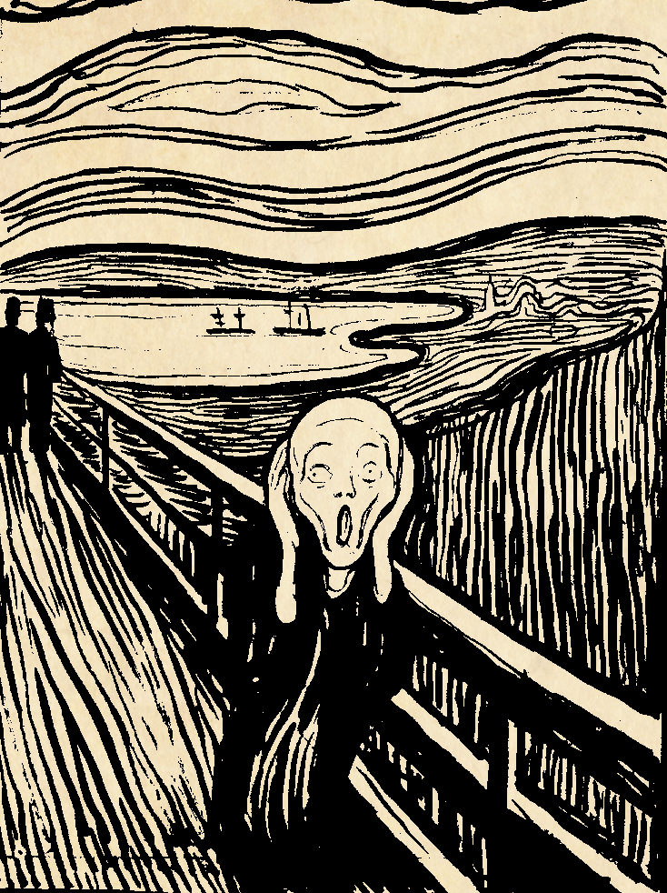
Deep-Seated Fear
Notes:
Evil emerges from profound existential fear. The destructive party believes everyone seeks to cause him harm. They view all others as threats and must defend themselves at all costs. Defense is usually covert and seeks to undermine or destroy through hidden means.

Slide 105

Existential Fear
Covert Acts or Bullying
Notes:
Destructive party usually operates covertly (as they are afraid): destroying you behind your back.
Destructive party with significant power may become a bully. More often the destructive party is covert, getting a bully to acts at their behest.

Slide 106
Traps
Notes:
Party attacked may experience being trapped. Web of lies, deception, and hidden influences entrap them.
May experience diminished sense of reality and lower certainty. Love may turn to rage.

Slide 107
Spider’s Web
Quicksand
Flypaper
Notes:
When trapped, we feel need to fight, to struggle.
When we use force, the trap tightens. It appears we cannot escape.
We struggle until worn out or we give up in despair.

Slide 108
The trap may involve:
Group Think
Cabals
Covert Agents
Power Imbalance
Notes:
The social landscape may be booby-trapped by the hidden influence working on the group.
The odds may seem overwhelming to those targeted by the hidden influence.

Slide 109
Snakes in Suits
Babiak & Hare
The Devil You Don’t Know
Louis Cameli
Narcissism and Dynamics of Evil
Douglas McMannaman
Notes:
Resources for studying how evil sets traps.
Compare “psychopath” with concept of evil.
Map the landscape of traps to be negotiated.

Slide 110
Walking Away
Notes:
In many instances, our best option is to simply walk away.
We may sacrifice. We suffer loss. We may lose face.
Yet walking away makes sense.

Slide 111
Francis’ Retreat into Solitude
Notes:
Francis sought solitude and unity with Christ.

Slide 112
Contemplation of Suffering
Notes:
We contemplate Christ’s suffering and view evil from His perspective.
With Holy Spirit at work, we view evil with a healing gaze.
In stillness with gaze of Holy Spirit we transform evil.

Slide 113
Spiritual Progress tends toward ever more intimate union with union with Christ.
Text
Notes:
Spiritual formation is vital for most extreme causes of conflict, which include intentions, forces, and causes we consider evil.

Slide 114
MEDIATION
Art of Restoring Harmony by seeking Unity in the Presence of the Holy Spirit.

