Slide 1
FRANCISCAN THEOLOGY
Spiritual Assistant/Formator Class
May 16, 2015
Sections adapted from the 2009 Summer Seminar available on http://www.nafra-sfo.org/Formation-FranciscanSpirituality/index.html

Slide 2
Theology leads to Spirituality
Purpose of theology – Bring us closer to God.
Franciscan theology gives the framework to Franciscan life.
  A loving God, Christ-Gospel-centered life FC-2
  Incarnation: For us to know God FC-2
  We are to do the will of God FC-2
Franciscan Perspective:
  Positive attitude,
  God’s love leads to better life,
  support for others.

Slide 3
Basic Catholic Theology
Common Elements
God is revealed through revelation.
Jesus Christ:
  Fullness of revelation: Through his words and his life.
  Guided by the Holy Spirit: Maintains the integrity of the message.
These four pillars of the Catholic faith are:
  The Profession of Faith – The Creed (What We Believe)
  The Celebration of the Christian Mystery – Liturgy and Sacraments (How We Celebrate)
  Life in Christ – Christian Morality (How We Live)
  Christian Prayer – A Personal Relationship with God (How We Pray)

Slide 4
Common Elements (Cont.)
Primacy of the Catholic Church :
  Historical claim;
  Guardian and teachers of the doctrine of Christ.
  Catechism of the Catholic Church
The Bible:
  God’s Holy Word.
  Christ is the Unique Word of Sacred Scripture.
  God speaks to us through the words of sacred scripture. Also FC-17
Trinity

Slide 5
Two ways of looking at the Incarnation
What is your view of God?
  Dominican View
  Franciscan View
Both are acceptable!
  Where is the Church going today?

Slide 6
Dominican View
Ascending – Latin – Primary Theology
Dominican School: Western Fathers; St. Augustine; St. Anselm of Canterbury, St. Thomas Aquinas. St. Benedict, St. Ignatius of Loyola, St. Dominic

Slide 7
St. Benedict
GOD is the Almighty, the Transcendent.
CHRIST is Our Redeemer and High Priest.
MAN is the Privileged Adorer, expressing the praise of all creation.
LITURGY is the principal "work" of the monastic community; it teaches and evangelizes.

Slide 8
St. Ignatious of Loyola
GOD is Creator, Lord, Owner of the Universe.
CHRIST is the King.
MAN is his soldier in the battle against evil.
PLAN of Life discovered in the Spiritual Exercises, the Examen of Conscience,
Personal Meditation.

Slide 9
St. Dominic
GOD is Truth.
CHRIST is the Word revealing the Father.
MAN is a Student seeking after Truth.
WAY of Life centered on Study, Science, and Preaching the Truth.

Slide 10
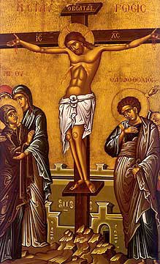
Most Christian
Spirituality
Points
to the Passion
Death &
Resurrection
Emphasis: redemptive suffering

Slide 11
St. Augustine -Original Sin
St. Anselm - Doctrine of Atonement
Dominican Tradition
Dominic & Thomas Aquinas
Essence
Intellect
Sin & atonement centered
knowledge
Jesus as expiation for sin
Work at worthiness
Earn salvation
Flee the world
Jesus – no
Pope Leo XIII
1879 Aterni Patris
Primary view –Juridical
Path of ascent

Slide 12

GOD – sanctity and holiness - spirituality
Spirituality of ascent
Seeking Perfection and holiness
primary & monastic spirituality to leave the world (by overcoming sin and the material world) to ascend to union with the Divine
(Spiritual or union of the soul with God)
Our Movement toward
GOD
Leaving behind the world to achieve the spiritual
US – Creation
The world, material
sin

Slide 13
  CHARACTERISTICS
Building a sense of boundaries e.g.Right & wrong.
Observance of Laws, rules, commandments, moral codes etc
Performance oriented – earn worthiness, earn salvation
Spirituality of Addition – more is better
Observance & Faithful attendance
Atone for sin, guilt, penance
Constantly re-doing our start up work

Slide 14
Standard view
Sequence of Creation
Creation Fall Redemption
But what if Scripture describes an
Alternative view of events

Slide 15
St. Augustine - Original Sin
St. Anselm - Doctrine of Atonement
The Cappodocians
Athanasius. Basil the Great
Gregory of Nyssa
Gregory Nazianzus
Dominican Tradition
Dominic & Thomas Aquinas
Essence
Intellect
Sin & atonement centered
knowledge
Jesus as expiation for sin
Work at worthiness
Earn salvation
Flee the world
Jesus – no
Pope Leo XIII
1879 Aterni Patris
Primary view –Juridical
Path of ascent
Franciscan Tradition
Francis & Clare
Bonaventure & Scotus
Person
Volition - WILL
Love-centered - sensory
affective
Jesus - blueprint of creation
Incarnation unites and transforms the world
Love the world – vestige
Jesus – Yes
Eph 1:3-14 & Col 1:15-20
Alternate view – relational
Path of Descent

Slide 16
Franciscan View
Descending – Eastern
  Eastern Fathers: Basil the Great, Gregory of Alssa.
  Followed by St. Bonaventure, Bl. John Duns Scotus
Franciscan view of creation: Begins with Blue-print before time
  Jesus always; (Timeline)
  The blueprint;
  The Master Plan;
  The First born of creation;
  Pre-existent Word
Goal of creation:
  All things created through Him, for Him and have their goals/fullness in Him.

Slide 17
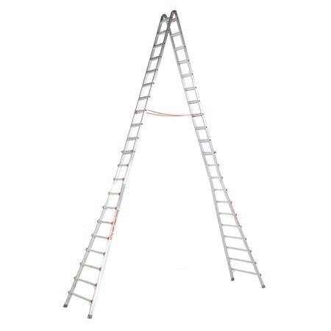
GOD
Our movement toward God
Ascending to spiritual union
By fleeing the world
God’s movement toward all creation
The Incarnation
transforms and unites material & Spiritual
All is good
All is holy
Us - Creation
Us – Creation – Material world, sin

Slide 18
Franciscan View of the
Creation Sequence
Beginning with the “Blue-print”
Jesus Christ
God's activity begins before time

Slide 19
Sequence of Creation
Jesus Creation fall Incarnation
Design Execution Completion
Jesus the Master Plan
First born of Creation – Alpha & Omega
Pre-existent Word- Logos
Center, focus, reason for creation, goal of creation.
All things created through, for Him & have their goal/fullness in Him

Slide 20
The Foundations of
Franciscan Spirituality
Incarnation – God’s greatest gift
Humility & Poverty of God
Jesus is the ultimate answer
Path of Littleness [descent] – creatureliness & dependence [contingency]
Mutual & reciprocal relationships

Slide 21
St. Augustine - Original Sin
St. Anselm - Doctrine of Atonement
The Cappodocians
Athanasius. Basil the Great
Gregory of Nyssa
Gregory Nazianzus
Dominican Tradition
Dominic & Thomas Aquinas
Essence
Intellect
Sin & atonement centered
knowledge
Jesus as expiation for sin
Work at worthiness
Earn salvation
Flee the world
Jesus – no
Pope Leo XIII
1879 Aterni Patris
Primary view –Juridical
Path of ascent
Franciscan Tradition
Francis & Clare
Bonaventure & Scotus
Person
Volition - WILL
Love-centered - sensory
affective
Jesus - blueprint of creation
Incarnation unites and transforms the world
Love the world – vestige
Jesus – Yes
Eph 1:3-14 & Col 1:15-20
Alternate view – relational
Path of Descent

Slide 22
St. Francis of Assisi
GOD is the Father [ABBA] who does everything out of love [Divine Nature].
CHRIST, in His Humanity, is the Beloved Son who shows us the Father; and is our Brother.
MAN has been reconciled [reunited] by Jesus and shares in the life of God who is Good, All Good, the Highest Good.
CREATION is the reflection of God's goodness; all are fellow creatures, our brothers and sisters. Everything shares in God’s nature and returns praise to the Father according to its unique nature – only man struggles

Slide 23
St. Francis of Assisi
WAY TO GOD is in the freedom of "sons & daughters,” who desire relationship with the Father, through Jesus in the Spirit
PRAYER is simple, affective, centered on the humanity of Jesus as seen in the Gospels. God is everywhere and any formula is good if it is the trusting prayer of a "son or daughter.“
How you journey determines How you arrive - Filled with much Joy.

Slide 24
Eucharist
Shown in Exhortations
E = Eucharist (IPE)
  For Francis the final act of God’s [Jesus] self-emptying. To be physically present in the lowest, poorest, humblest manner of food
  Eucharist and reverence
  This manner of giving on God’s part is our model for imitation
Living it

Slide 25
How Francis saw God and Jesus
Not a theologian. – Directed by what God showed/communicated to him.
Saw God in creation. Simplicity
God is love
Poverty & Humility
  Incarnation, Passion/Crucifixion, Eucharist
Trinitarian: Relationship
  A model for us: Imitate the Trinity: a model of collaboration.

Slide 26
Questions for Part 1
What was your image of God? What do you hold on too? How has it changed?
Consider the different focus between these 2 major Spiritual Traditions. How might the difference affect your approach to God and Life.

Slide 27
Boneventure
Trinity
The Breviloquium (7 Chapters)
    On the Trinity of God
    On the Creation of the World
    On the corruption of Sin
    On the Incarnation of the Word
    On the Grace of the Holy Spirit
    On the Sacramental Remedy
    On the Repose
The Souls Journey into God. (7 day journey.)

Slide 28
Bonaventure
The second founder of the Order
The Trinity [from the Cappadocians]
Begins with person not substance
Identifies the Trinity on the basis of inter-Trinitarian [interpersonal] relationships

Slide 29
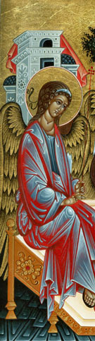
The Father
  Supreme goodness
  Unbegotten source
  Total giving-ness – generativity/fecundity
  2 modes of emanation
    Intellect – Beloved Son
    Will – Spirit = freedom’s choice to Love

Slide 30
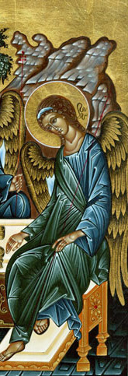
Will of God – Holy Spirit
  Spirated from both Father & Son
  Total receptivity
  Receptive; not productive
  Mutual bond between Father
  & Son
  The expression of God’s will
  LOVE
    choice made in absolute
    freedom

Slide 31
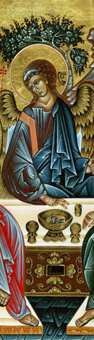
Intellect Beloved Son
Eternal Word
  Begotten
  Perfect receiver and reflector of God
  All God is expressed in the Son
  Jesus unites the coincidence of opposites
Both receives and produces [spiration]
Dynamic center
Exemplar - makes visible the ideas, thoughts, actions [mind] of the Father
“. . if you see me, you see the Father”

Slide 33
Trinity
  • humility, poverty, giving-ness is an essential aspect of God's nature of Love - [self-communication and expression]
  Fountain fullness – constantly outpouring, overflowing
  Fullness & emptiness
“bonum sui diffusivum est”
goodness is diffusive by its very nature
this is the very heart of Franciscan Theology

Slide 34
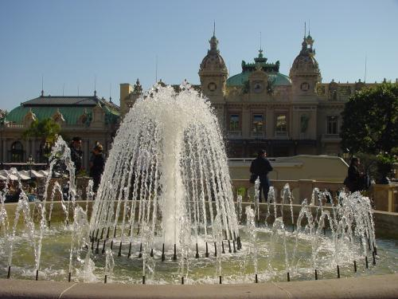
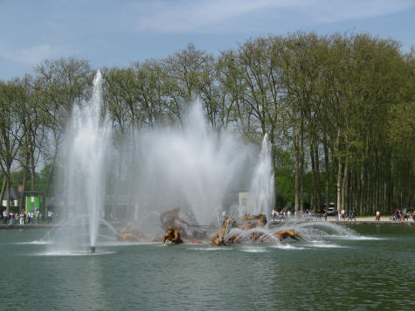
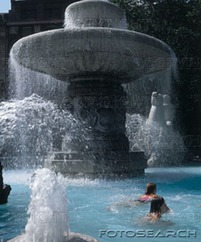
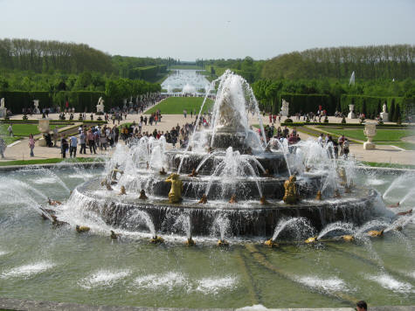
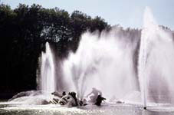

Slide 35
Coincidence of Opposites
Father = total generativity – total giving
Spirit = total receptivity (from Father & Son)
Beloved Son = total giving and total receptivity – receives all the Father is and reflects it all back
These characteristics fulfill all possibilities of perfect Love and mutuality

Slide 36
The Breviloquium
Book 1 -- Book of Creation:
The created world is like a book in which its maker, the Trinity, shines forth, is represented and can be read at three levels of expression:
  vestige, is found in all creation
  image, is found only in intellectual beings or rational spirits
  similitude, is found only in those creatures which have become conformed to God

Slide 37
Book 2 – Book of Life -- Jesus Christ
Jesus is God’s masterpiece and therefore the blueprint of creation
  • goal and focus of all creation
  • completes and is the fullness of creation, begins the notion of cosmic Christology
  Lastly and least important: Jesus in the Incarnation as a remedy for sin

Slide 38
Incarnation
God comes down (Path of Descent)
God bends down to embrace us in Love,
to lift up our nature and all of creation
to invite us into the Dance of the Trinity
If God bends down in love for us through the Word Incarnate, then we who are “little words” must bend down in love for one another and for all creation if the universe is to find its fullness in Christ

Slide 39
The Soul’s Journey Into God
The 7 days of the Soul’s Journey into God
Goal of every Christian to undertake this journey

Slide 40
Day 1 & 2 - Creation
World is not an obstacle to union with God
Francis – Canticle of Creatures
Do we make it a point [like Francis] to see BEAUTY in beautiful things [creation]
Do we pay attention and see beyond appearances
Do we observe natural order – reflection of God’s wisdom

Slide 41
Day 1 & 2
World outside comes to us through our senses [from St. Augustine] and the world begins our journey into God!
  Sight – enables us to see Beauty,
  Touch – blessing, healing, compassion
  Taste – God’s words are sweet, honey
  Hearing – the sounds of harmony,
  Smell – Words of God like fragrant flowers,
Senses bridge the gap from outer to inner

Slide 42
Day 3 & 4 -- Moving Inward
Human inner trinity/capabilities of memory, intellect and will. These 3 capacities show us the beauty of ourselves as a reflection of God
  memory – enables us to live in the Now, yet recall things of the past and imagine our tomorrows. Transcend time, sharing an attribute of our God

Slide 43
Day 3 & 4
  Intellect -- our ability to reason, to distinguish between the true and false selves. Who we are with out our masks, naked before God – authentic self
  Will -- our basic orientation toward God linked with our ability to choose. We share God’s absolute freedom of action. Our YES and also our NO

Slide 44
Day 4
Expands our inner world to include our willingness to be informed/enlightened by Grace.
  sin blunts our ability to choose well or wisely
  grace helps in seeing and making better choices

Slide 45
Day 5 & 6 Above
Turning our attention (contemplation) above ourselves
  trying to see God as God is – not our constructs or images
  gazing into more light (darkness)
  acknowledge our contingency
Day 5 tries to see God as one
Day 6 sees God as Trinity

Slide 46
Day 7 Rest
From Bonaventure’s experience on La Verna, Day 7 is the final overwhelming of our understanding. We must give over (die to self) even our will to fully enter into the dance of the Trinity.
Here intellect yields to feeling (affective or experiential) and it becomes clear that the answer to every question is found only in Jesus

Slide 47
Blessed John Duns Scotus
The Primacy of Christ
Haecceitas - Thisness

Slide 48
Bl. John Duns Scotus
Absolute Primacy of Christ
The Incarnation is not a divine after thought or reaction to any event.
Intrinsically It is the cornerstone of the whole plan of creation.
Everything that was, is & ever will be is based in Christ.

Slide 49
For Scotus, Incarnation is too important to be caused by sin – final break with more popular theology of Aquinas.
Incarnation is not plan B because man caused plan A to go awry.
Jesus is God’s masterpiece and was the intention of all creation and is the original plan before even time.

Slide 50
The relationship between divinity & humanity:
  God & humanity are intrinsically, organically united and all creation is centered in Jesus.
  Creation is based on God's absolute freedom and love, e.g God's very nature, and not a need.
  Firmly roots Franciscan Spirituality in the Person of Jesus, the radical experience and witness of Francis.

Slide 51
The reasons:
  Love – God’s absolute love desires to share that love
  God’s desire to be Love is a free act!
  Created in the blueprint of Jesus we are made as co-heirs to the Trinitarian Love Jesus experiences.
  The Incarnation is the unrepeatable, unique and single defining act of God’s love

Slide 52
Incarnation demonstrates the desire for love is greater then even the need for redemption,
God’s love is both totally free and unconditional, accepting of all that we are.
For Franciscan Spirituality, the Incarnation is the guarantee of union with God

Slide 53
Scotus - Thisness [haecceitas]
The doctrine of thisness applied to the human person invests each individual with a unique value as one single individual wanted and loved by God, apart from any trait, attribute, accomplishment, similarity to others or any contribution to society.
Of the infinity possibilities for a “you” the specific, unique “you” is the one wanted & loved by God and called into being.

Slide 54
Franciscan Theology Recap
Though most of Francis’ prayers are directed at the Holy Father, he calls Jesus, “Elder Brother”, the Incarnate Crucified Lord of all creation, the heart and center of the Trinity and our model/exemplar

Slide 55
Francis comes to know Jesus as the “Beloved Son” and is compelled to imitate Jesus so to also become the beloved of the Father.
In Jesus Francis sees the totality of who the Father is.
Imitating Jesus is to live as God lives

Slide 56
In his writings Francis addresses God as Father or in Trinitarian form most of the time.
The Holy Spirit is the source of love and Joy within us that empowers us to live the Gospel
The Spirit draws us to become transformed and conformed to Jesus

Slide 57
Jesus is the mediator or the center of Trinitarian Life
As Francis points us to Jesus, Jesus always points us to the Father

Slide 58
God, Holy father, is the source of generativity
The Father is the unbegotten one
The source of unbounded and eternally overflowing love
God’s love is kenotic [self-emptying] always focused on the other
God desires us

Slide 59
Change in direction of the Church since Vatican II
  From Apostolic Acts to Life based on Jesus.
    Life based on Image of God; Relationships; and a way of life
      Francis Way of Life: Based on Divine Economy
        Divine Economy to Human Economy

Slide 60
Divine Economy to Human Economy Michael Crosby OFM Cap
  All are equal, created in the divine image (Jesus) - The Blueprint.
  God has entered into mutual relationship with each one (as well as all creation) - God’s Poverty (Incarnation) & Humility (mutuality – desiring us).
  Resources are to meet the needs of all so that all realize their dignity and have the fullest potential, mutuality, & participation.

Slide 61
Insights of the Franciscan Spirit
Franciscan Family Concerns: (FC-14)
Needs of the poor and marginalized
Peace and justice
Work as a gift from God
Prayerful and Contemplative
Eucharistic people. Bring Unity
  Presence of Christ in the word, in the priest, in the assembly, in the Eucharist and other sacraments.
Blessed Virgin Mary is a model for the Franciscan Family.

Slide 62
Insights of the Franciscan Spirit
Franciscan Family Concerns (Cont.):
Interactive: Work with other members. Every one freely gives. Everyone freely receives.
Community-minded. Not Individualistic as the call of society suggests.
Beware of strange beliefs.
A sense for forgiveness and reconciliation leading to freedom.

Slide 63
Questions
Do members of your fraternity understand the two traditions? Do they understand where our life style is coming from?
How might you take this back to your fraternity?
How do we show Godly characteristics in our human actions and relations?

Slide 64
Questions
What was your image of God? What do you hold on too? How has it changed?
Consider the different focus between these 2 major Spiritual Traditions. How might the difference affect your approach to God and Life.
Do members of your fraternity understand the two traditions? Do they understand where our life style is coming from?
How might you take this back to your fraternity?
How do we show Godly characteristics in our human actions and relations?

