Slide 1
On-Going Formation
Purpose
Content
Time
Prayer

Slide 2
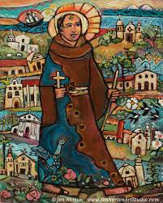
Blessed Junipero Serra HISTORY

Slide 3
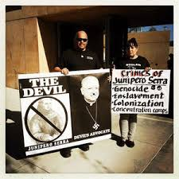
Canonization Controversy

Slide 4
SMALL GROUP QUESTIONS
Fr. Serra challenged the political leaders of his time and fought for the rights of the Indians. How are you or your fraternity involved in supporting injustice in our society?
Many of our Native American brothers and sisters still suffer economically, spiritually, and physically. Are there ways to minister to them today?
How does Serra’s motto apply today to you or your fraternity’s life? “Always go forward. Never turn back.”
What insights have you gained on Serra’s life, his canonization, or his relevance to your life?

