Slide 1



Slide 2
“I AM THE BREAD OF LIFE.”
“I AM THE RESURRECTION, THE LIGHT.”
“I AM THE TRUTH, THE WAY.”
STATEMENTS OF A GENTLE LOVER OR A RADICAL.

Slide 3
First Century Judaism
Temple - heart and soul of hope for Jewish people
2. God would vindicate his people
3. Messiah in the nature of the warrior king David
4. God of the Hebrews only

Slide 4
Jewish expectations during Jesus’ time
1. Messianic expectations very high
2. Jewish people looking for the messiah
3. Could Jesus be the one?
4. Jewish messiah would give freedom to Hebrew nation

Slide 5
What Jesus meant to the authorities
1. He challenged the social foundations
2. He challenged the foundations of everything
3. Require total allegiance to Him.
4. Prophecy fulfilled
5. Challenged concept of God
6. Parables or stories were subservient

Slide 6
Who was this Jesus?
1. just a commoner?
2. a nobody?
3. a low-life?
4. a Nazorean?
5. “Could anything good come out of Nazareth?”
6. Teacher, prophet, anarchist?
7. God?

Slide 7
Parable of the Prodigal Son
1. Prodigal son is the gentile world
2. Father is God
3. Older son is Jewish nation

Slide 8
The Parable of the Good Samaritan
Cast of characters:
1. Priest
2. Levite
3. Samaritan man
4. The injured man

Slide 9
The Parable of the Wicked Tenants
Cast of characters:
1. The people in the vineyard
2. The owner of the vineyard
3. The servants of the owner
4. The son of the owner

Slide 10
The Parable of the Great Banquet
1. Invitation sent to guests
2. Invitation sent to all the outcasts

Slide 11
Is Jesus Burning Bridges???
1. Accuses Pharisees of miss-applying the laws
2. 39 sub-divisions of laws that were to be observed on the Sabbath.
3. Sabbath Day – a day of simplicity vs. stressful
4. Sabbath Day made for man not man for the Sabbath
5. “I am the Lord of the Sabbath”
6. Most of laws had no scriptural background
7. Purity requirements
8. Pharisees dining vs. Jesus’ dining
9. Let the dead bury the dead

Slide 12
WE AS FRANCISCANS…
1. Called to follow in footsteps of St. Francis and our Lord Jesus Christ
2. Live out Gospel to life and life to Gospel
3. Live out our Rule
4. Follow the two Great Commandments
5. Do Right – Do Good
6. Live in imitation of the world’s greatest radical – Jesus Christ

Slide 13
WE HAVE BEEN CALLED
ARE YOU READY TO ANSWER
THE CALL AS FRANCIS DID?

Slide 14
WE ARE THE LIGHT OF THE WORLD.
CHRIST HAS PASSED THE TORCH TO YOU AND ME.
WE ARE THE NEW RADICALS EVANGELIZING FOR THE KINGDOM.
IT IS WHO WE ARE.

Slide 15
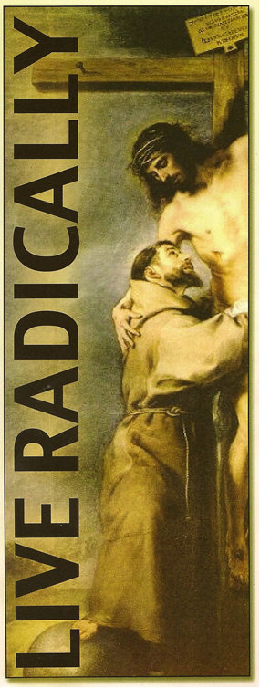

Slide 16
1. We are called to be radicals in today’s world. Why? How?
2. In the parable of the prodigal son are we the older brother who never left but complains?
3. Do we support man’s law over that of moral law? If so, why? If not, why?
4. Can we live out the radical lifestyle of Jesus and our Rule in today’s world?
5. How do we bring “light” to the world today?

