Slide 1

Frank Miller, OFS

Slide 2
Servant
Leader

Slide 3
Servant

Slide 4
Leader

Slide 5
Servant

Slide 6
Leader

Slide 7
Servant
Leader

Slide 8
Leader
YOU

Slide 9
Servant
Leader
YOU
The
Other

Slide 10
What are some of the reasons we fear leadership roles?

Slide 11
What are some of the reasons we fear leadership roles?
Discerning your gifts/skills/talents
IS NOT
a lack of humility!
A humble spirit looks UP, not down.
* * * * * * * * * *

Slide 12
What are some of the reasons we fear leadership roles?
Discerning your gifts/skills/talents
IS NOT
a lack of humility!
A humble spirit looks UP, not down.
* * * * * * * * * *
The gift you have received,
give as a gift. Mt. 10:8

Slide 13

WHAT IS YOUR GIFT?
My gift is:_________________

Slide 14
What is Servant Leadership?

Slide 15
What is Servant Leadership?
We are all a product of our experiences, and some of those come from the workplace.
Many confuse the role of a leader, with the role of a manager or authority.

Slide 16
Leaders inspire us to be more than we think we can be.
JFK
Many others:
  Ghandi
  Mother Theresa
  Nelson Mandela
  Malala Yousafzai
  President Obama
  Pope Francis I
  Billy Graham
  Oprah
  Personal heroes
Within this decade, we will go to the moon…
  8 ½ years later, US landed on the moon.
A group of talented men and women who would dedicate themselves to the progress and peace of developing countries.
  Since 1961: 215,000 people serving in over 139 countries.

Slide 17
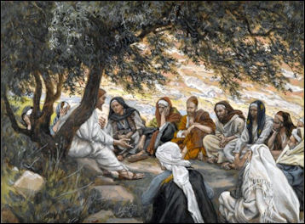
Matthew 20:27-28
Christ as servant leader:
Anyone who wants to be great among you must be your servant….just as the Son of Man came not to be served but to serve.

Slide 18
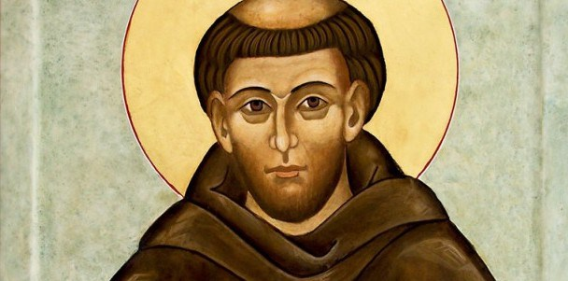
Testament of St. Francis
Francis as servant leader:
After the Lord gave me brothers, no one showed me what I should do; but the Most High Himself revealed to me that I should live according to the form of the Holy Gospel.

Slide 19
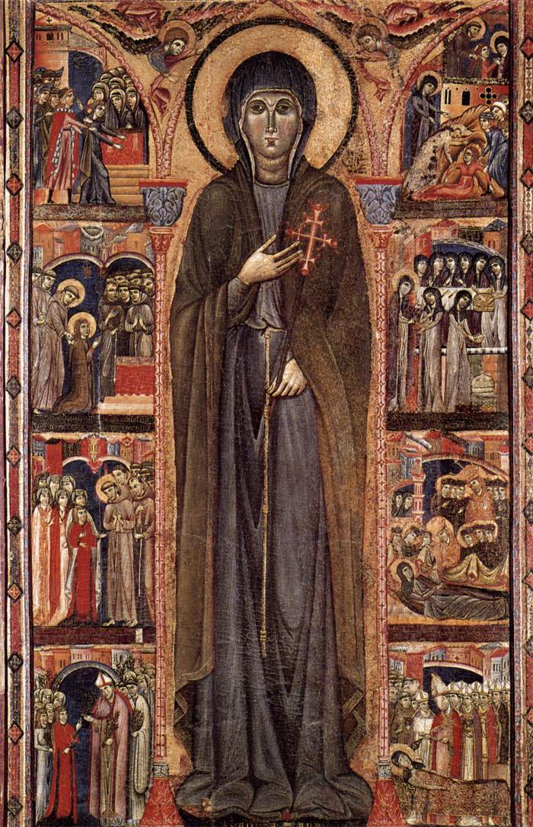
Rule of Clare
Clare as servant leader:
She should strive as well to preside over the others more by her virtues and holy behavior than by her office.

Slide 20
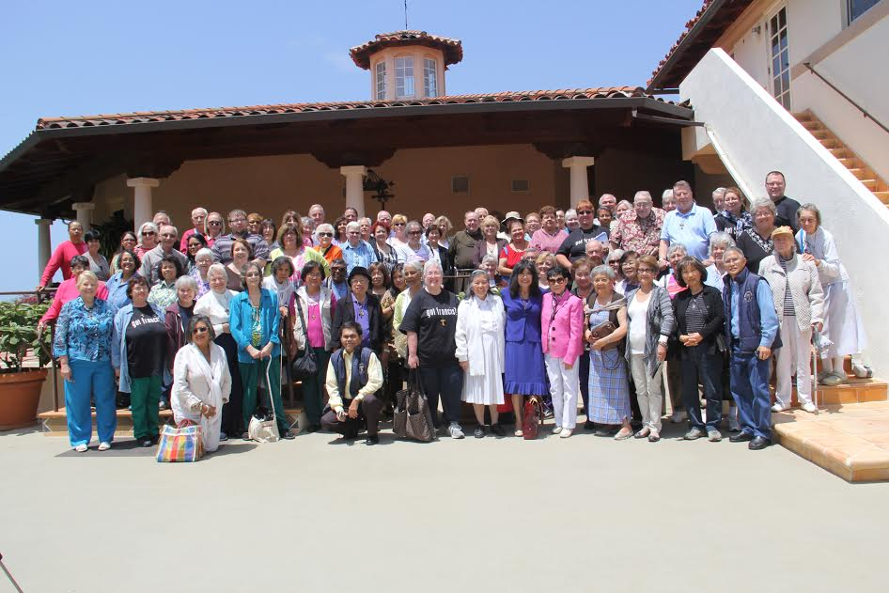
YOU as servant leader:

Slide 21
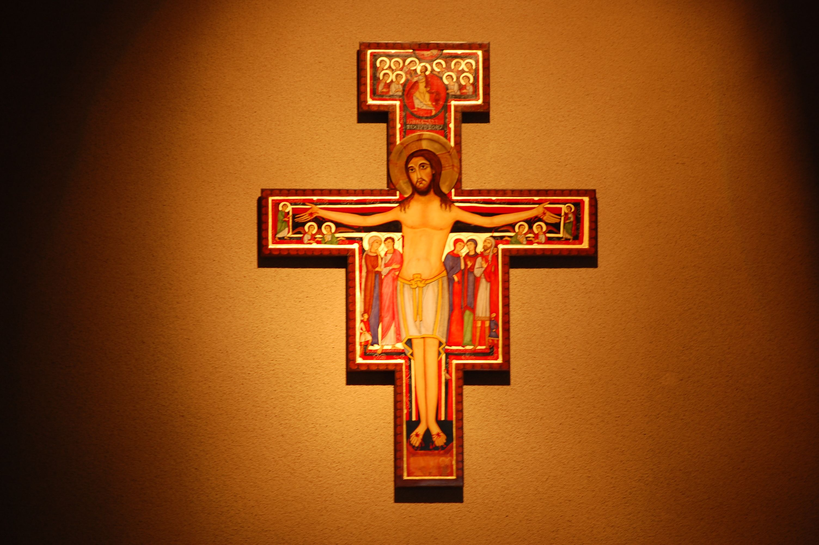
I intend to be of service to all through my secular state of life for the glory of God and to fulfill His plan of love in behalf of all people
Rite of Admission to OFS

Slide 22
I, by the grace of God, renew my baptismal promises and consecrate myself to the service of His kingdom.
Rite of Profession to OFS

Slide 23
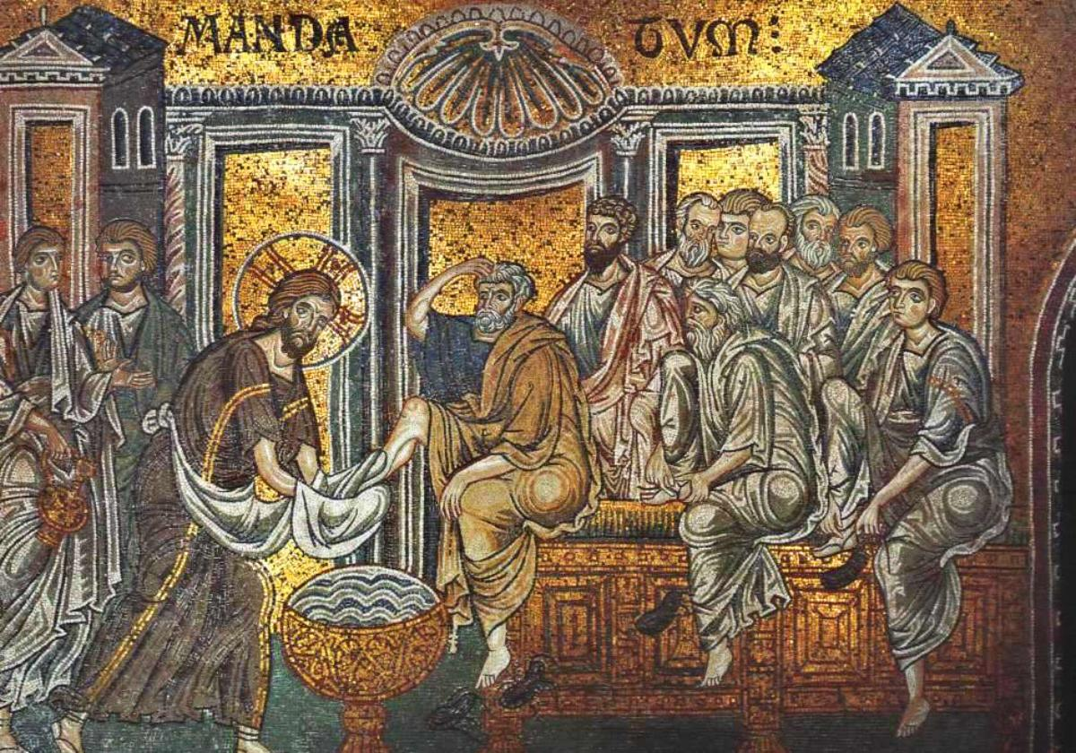
John 13: 4-16

Slide 24
He got up from table, removed his outer garment …and began to wash the disciples feet and to wipe them with the towel he was wearing.

Slide 25
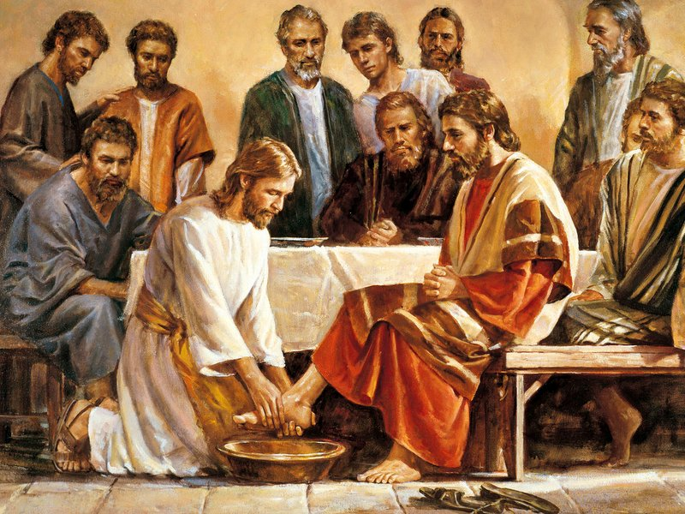
He got up from table, removed his outer garment …and began to wash the disciples feet and to wipe them with the towel he was wearing.
Do you not understand…If I have washed your feet, you should wash each other’s feet. I have given you an example so that you may copy what I have done to you.

Slide 26
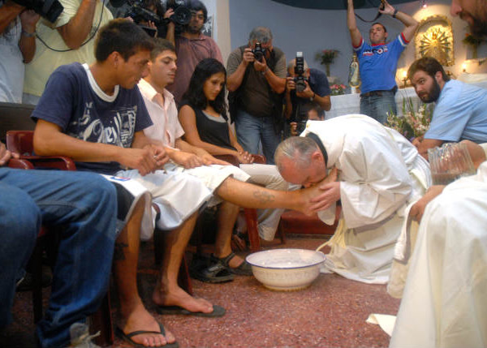
He got up from table, removed his outer garment …and began to wash the disciples feet and to wipe them with the towel he was wearing.
I tell you most solemnly, no servant is greater than his master, no messenger is greater than the man who sent him.
Do you not understand…If I have washed your feet, you should wash each other’s feet. I have given you an example so that you may copy what I have done to you.

Slide 27
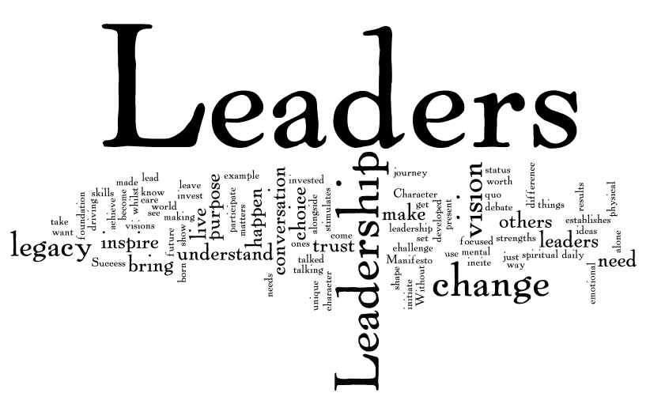
Are you called?
YES!

Slide 28

RELATIONSHIPS:
Easy-Peazy?

Slide 29

Leadership Styles
- Directing
- Coaching
- Supporting
- Delegating

Slide 30
Leadership Styles
- Directing
An early stage in leading; people need to be more closely monitored, given clear, directive instructions, need feedback, and corrective interaction is often needed to further understanding and/or compliance.

Slide 31
Leadership Styles
- Coaching
A significant investment in the Leader’s time. Need to provide regular reinforcement, feedback, support and “re-charge” the confidence and ability of the other individual. Not tell, but guide.

Slide 32
Leadership Styles
- Supporting
Support of a person who is more confident and capable, but still needs advice as decision milestones are reached; leader is more of a “sounding board”. There is a high degree of trust in this relationship. Mentor.

Slide 33
Leadership Styles
- Delegating
The leader has the ability to rely on the other to independently complete their tasks. Give the individual the goal, and let them take it from there. Occasionally touching-base to ensure everyone is on the same page.

Slide 34


Slide 35
Discussion Questions
What thoughts/ideas do you have on moving the concept of servant leadership to FRANCISCAN servant leadership? How would you explain it to someone else?
What qualities of servant leadership resonate with your life and ministries?
Being a leader can be scary for someone; what can you do to help them understand the value they would bring to a servant leader role? Describe the conversation.

